Slide 1
Reducing Torque Ripple of Brushless DC Motor by Varying Input Voltage
Authors: Ki-Yong Nam, Woo-Taik Lee, Choon-Man Lee
Jung-Pyo Hong
Publication: IEEE Transactions on Magnetics, April 2006
DOI: 10.1109/TMAG.2006.871937

Slide 2
Abstract:
This paper investigates the problem of torque ripple in brushless DC motors and proposes a method for reducing it using variable input voltage.
This study introduces a method utilizing variable PWM voltage to significantly reduce torque ripple.
The study demonstrates the effectiveness of this approach through simulations and experimental testing, highlighting its potential benefits for applications requiring smooth motor operation.

Slide 3
Objectives:
Analyze the causes of torque ripple in BLDC motors.
Investigate the effectiveness of variable input voltage in reducing torque ripple.
Evaluate the impact of varying input voltage on motor performance parameters.
Identify potential applications for the proposed method.

Slide 4
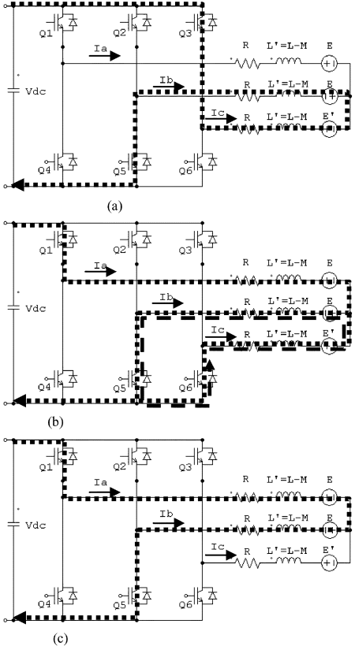
System diagram: Fig.1. Current flow of the BLDC motor. (a) Before commutation. (b) At commutation with freewheeling region. (c) After commutation with build-up region.

Slide 5
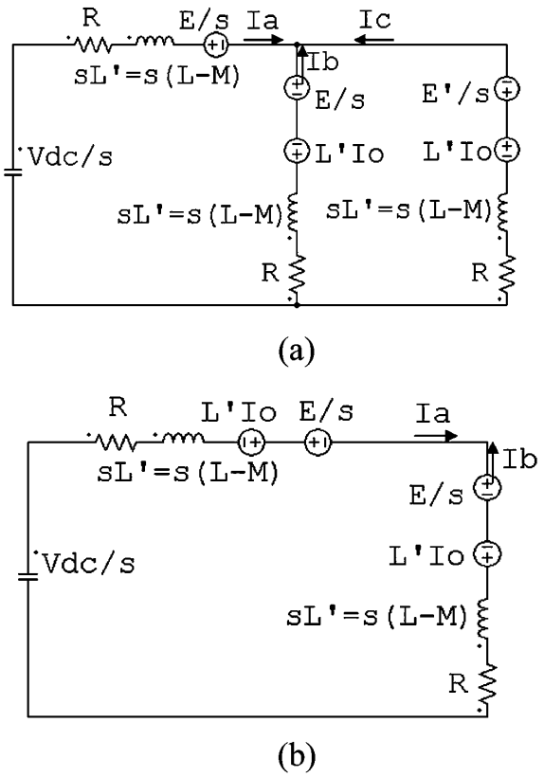
Fig.2.Equivalent circuit of using the Laplace transformation. (a) Freewheeling region. (b) Build-up region.

Slide 6
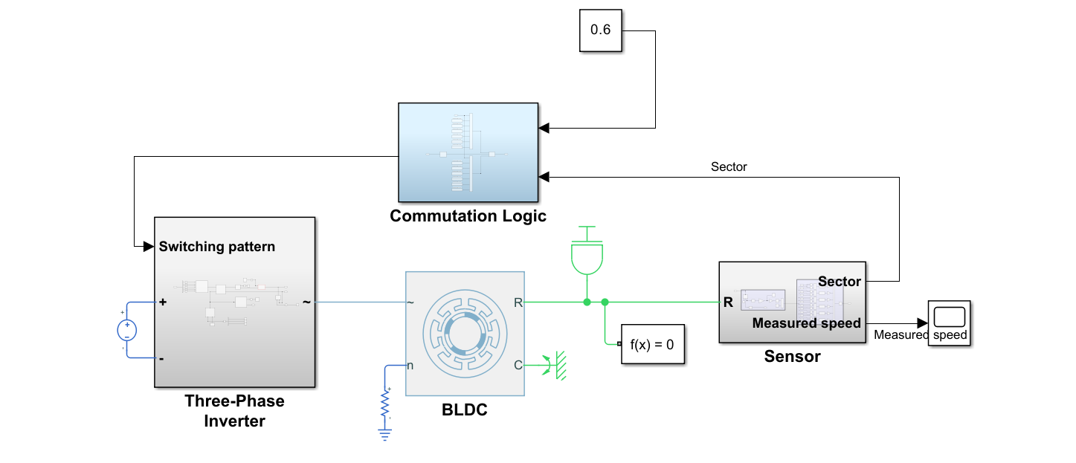
Simulation model of Bldc motor:

Slide 7
Results:
Significant Torque Ripple Reduction: The proposed method using variable input voltage successfully reduced torque ripple in the BLDC motor by 10% compared to the constant voltage control. This improvement contributes to smoother motor operation and reduces noise and vibration.
Effective Voltage Variation: The study investigated different levels of voltage variation and found that increased variation led to greater reductions in torque ripple. However, beyond a certain threshold, the efficiency and power output of the motor started to decrease.

Slide 8
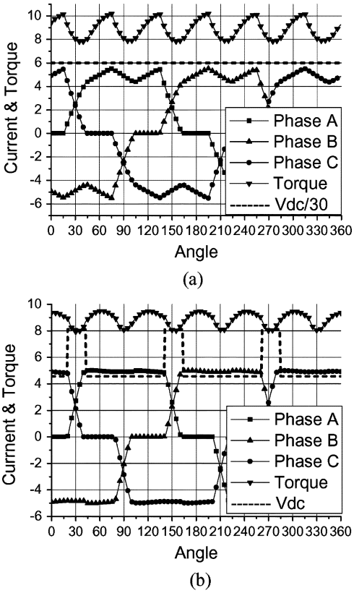
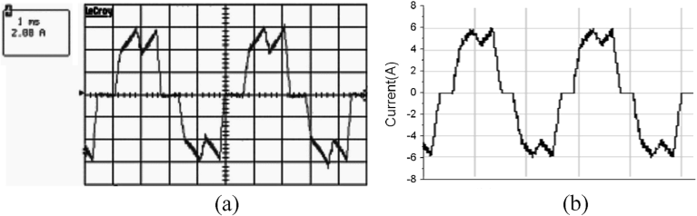
Fig.3.Current waveform of 500 W BLDC motor at 6660 rpm. (a) Experimental data. (b) Simulation data.
Fig.4.Current and torque waveform in simulation. (a) Constant input voltage. (b) Various input voltage.

